Slide 1
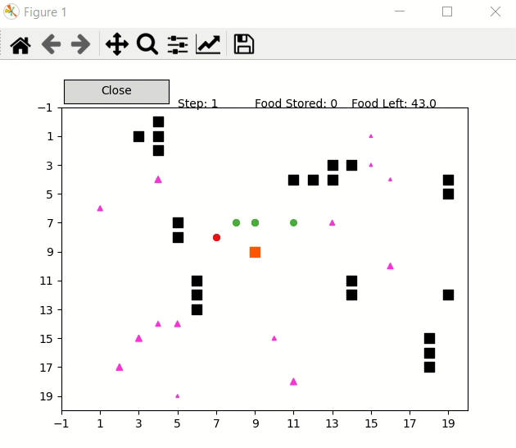

Ant-Based Multi-Agent Reinforcement Learning
Ants have been used as a source of inspiration in many learning environments within reinforcement learning.
This project attempts to use ideas from multi-agent reinforcement learning on an ant-based domain.
The environment consists of nest, food, obstacles and ants. Ants have to learn to find food, avoid running into obstacles, and return with food to the nest as quickly as possible.
The simple use of pheromone trails allows communication among ants, thereby providing a way to circumvent communication and coordination problems in multi-agent algorithms.
Fig. 1

Slide 2
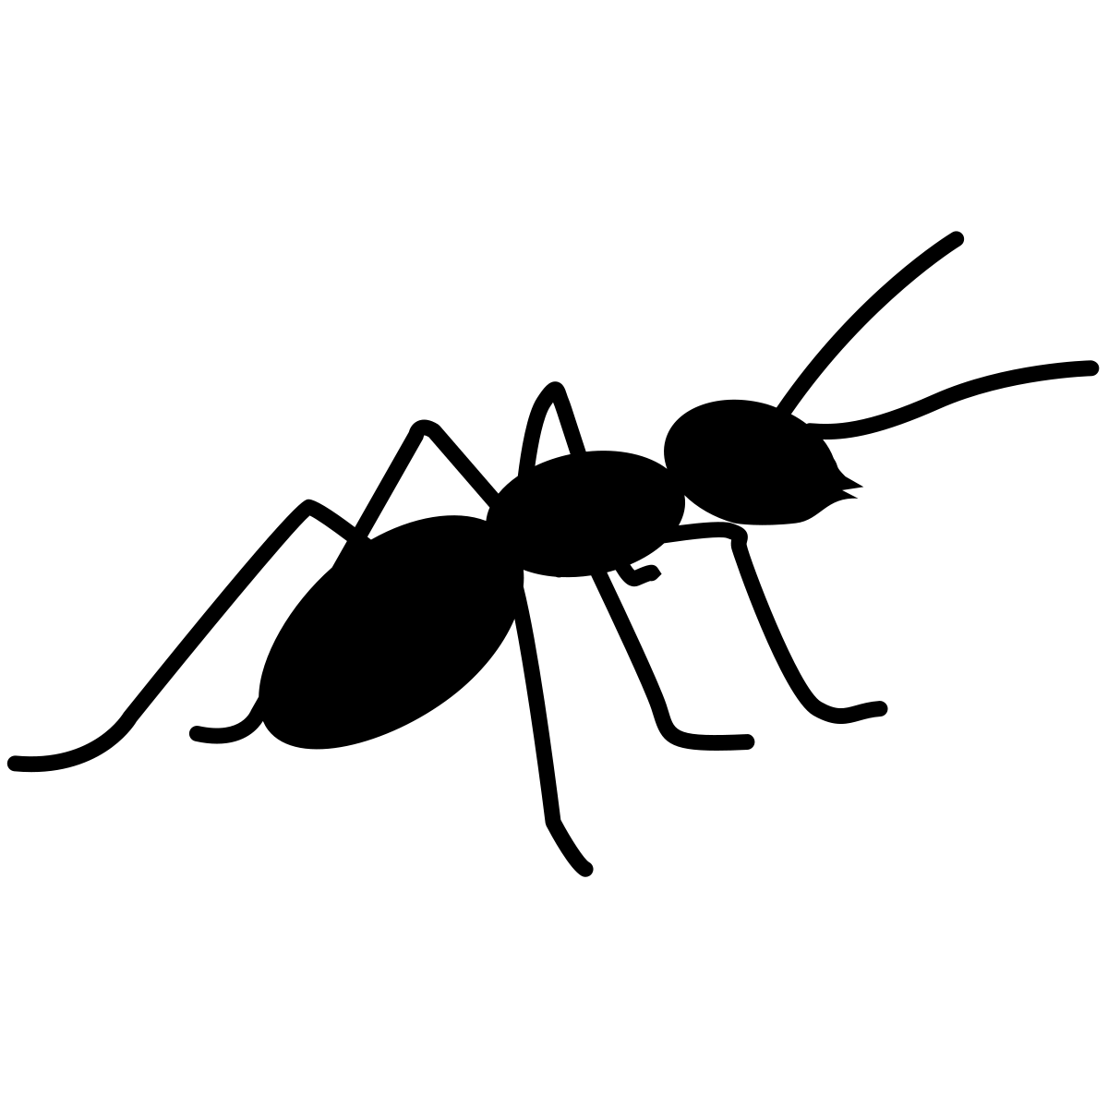
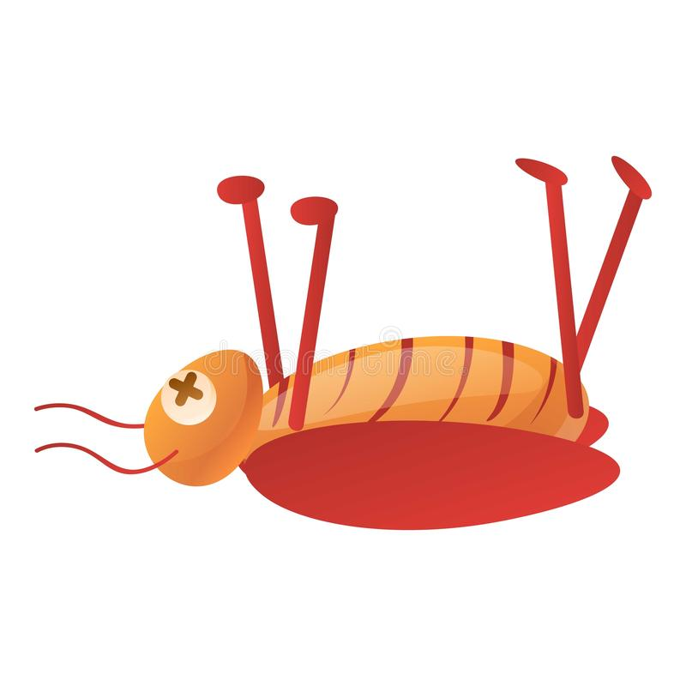

Model Parameters, Agents, Rewards
Ants, which act as agents, are divided into two types:
Exploring ants: Focused on finding new food resources and areas
Exploiting ants: Focused on collecting food from known food resources
Some of the model parameters include:
Environment size, number of food morsels, number of obstacles
Number of ants, percentage of exploring ants, location of nest
The Fig. 2 beside gives an idea of the reward function.
Foraging ant
+10
Food
Ant with food
+1
-1
+0
Pheromone trail
Nest
+20
Fig. 2

Slide 3
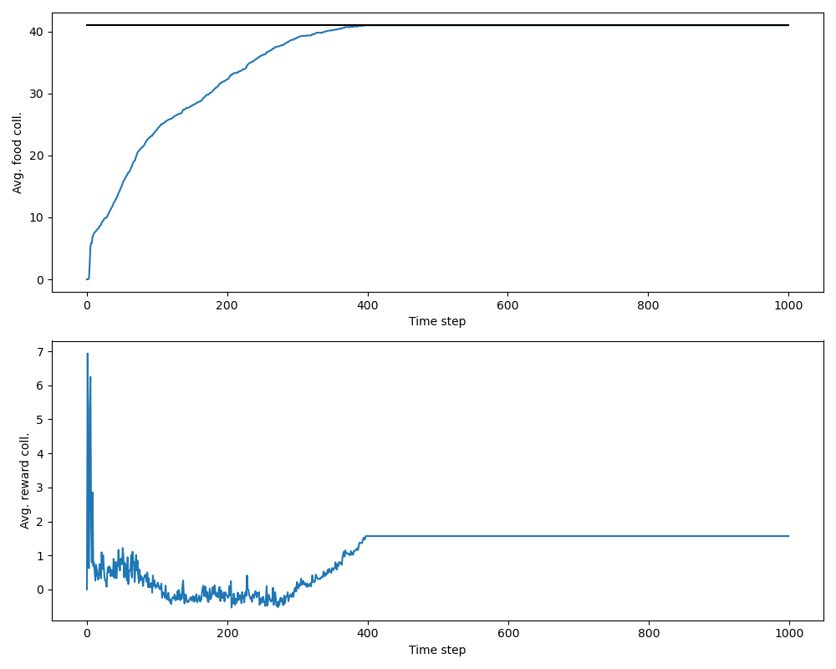
Procedural Ant
This is a deterministic algorithm, meaning ants know what to do. Main parts of the pseudocode include:
Start from nest, explore, avoid obstacles, follow trails if present
Find food, return to the nest, lay a trail or reinforce one if following
Fig. 3 shows food and reward collected during a run length of 1000 steps, averaged over 20 epochs.
Since no learning is required, ants collect the food pretty fast.
Fig. 3

Slide 4
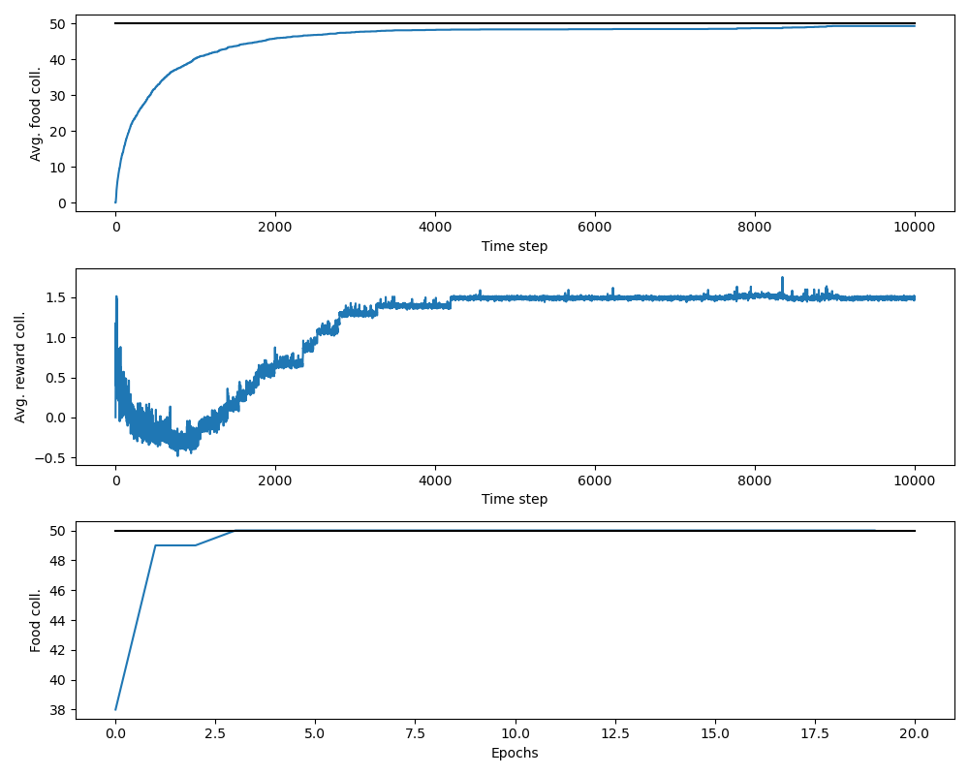
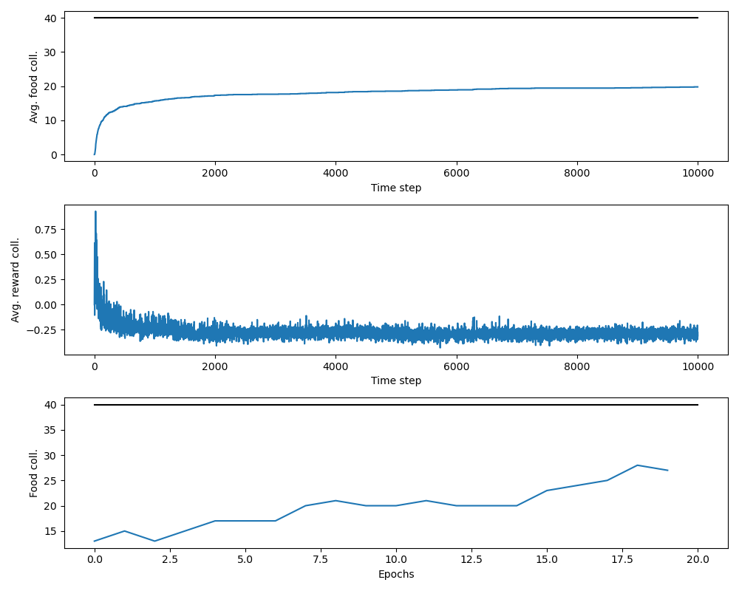
Joint and Decentralized Learning Ant
These two algorithms use Q-Learning modified for a multi-agent system
Joint Q-Learning involves state-action Q-values updated and shared by all ants simultaneously.
Decentralized Q-Learning requires every ant to have its own set of state-action Q-values, based on its learning.
Figs. 4 and 5, from top to bottom, show food and reward collected over 10000 time steps averaged over 20 epochs, and food collected per epoch, for Joint Q-Learning and Decentralized Q-Learning respectively.
As ants learn, they collect more food every epoch.
Since Q-values are common to all ants in Joint Q-Learning, it is much faster than Decentralized Q-Learning.
Fig. 4
Fig. 5

Slide 5
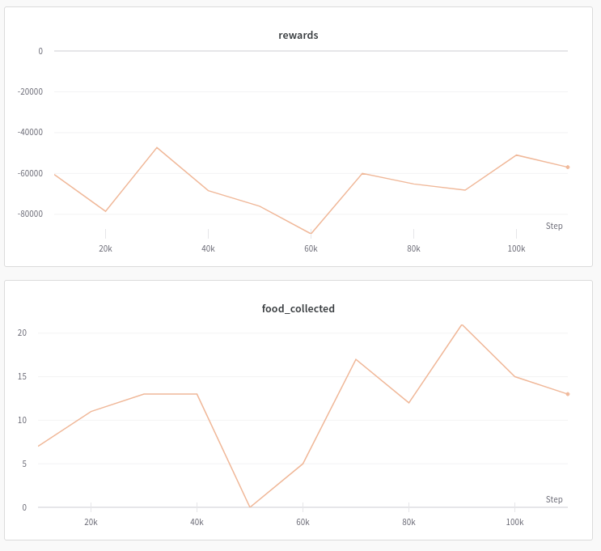
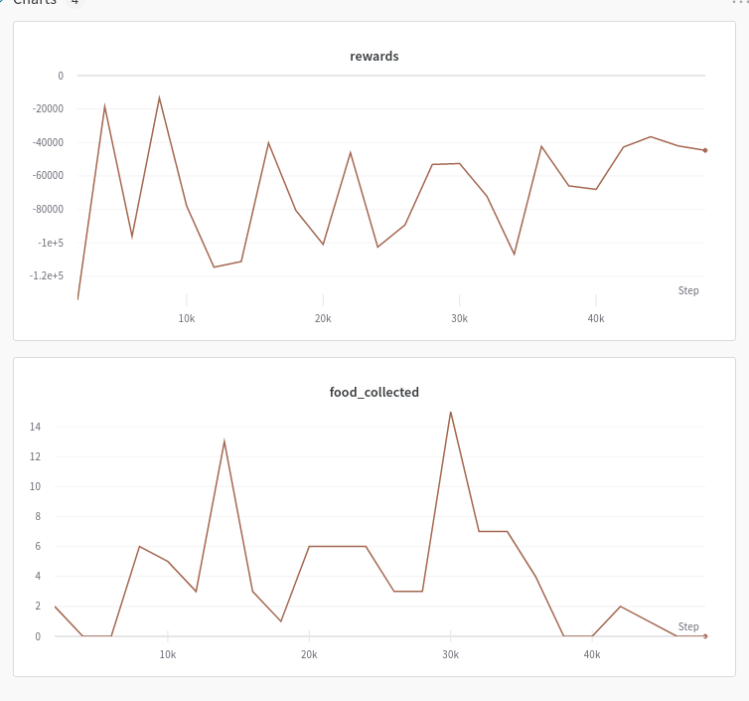
Centralized and Deep Centralized Learning Ant
For these models we experimented with stochastic environments to produce robust/complex behaviors.
We took all the information available to the Procedural agent and put it into the state space.
Due to the large state space, we had to use a centralized learning algorithm.
We tried both traditional Q-Learning and Deep Q-Learning
We also experimented with a partially offline version of the Deep Q-Learning model.
Online
Hybrid

Slide 6
Discussion
The project shows that ant-based model has a number of learning opportunities.
Modification of simple Q-Learning for multi-agent systems, modeling as close as possible to real life, etc. are some of the ideas put forth in this work.
These ideas can be improved in ways including optimization of hyperparameters, intensive testing of reward function, increasing convergence rate, reducing bias, etc.
An extension to the model can be a completely stochastic environment where food, obstacles appear and disappear randomly.
The project endeavors to provide motivation for research in such bio-inspired domains.
Thank You!

